Slide 2
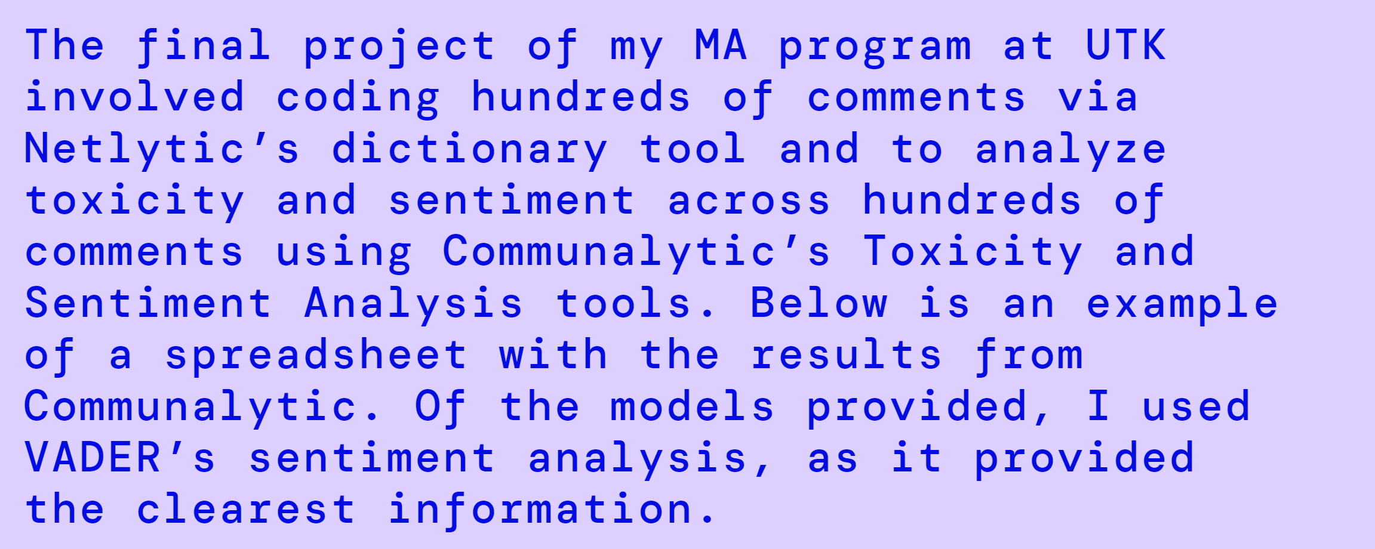
Student Thesis
https://hannahtrammell8.wordpress.com/

Slide 3
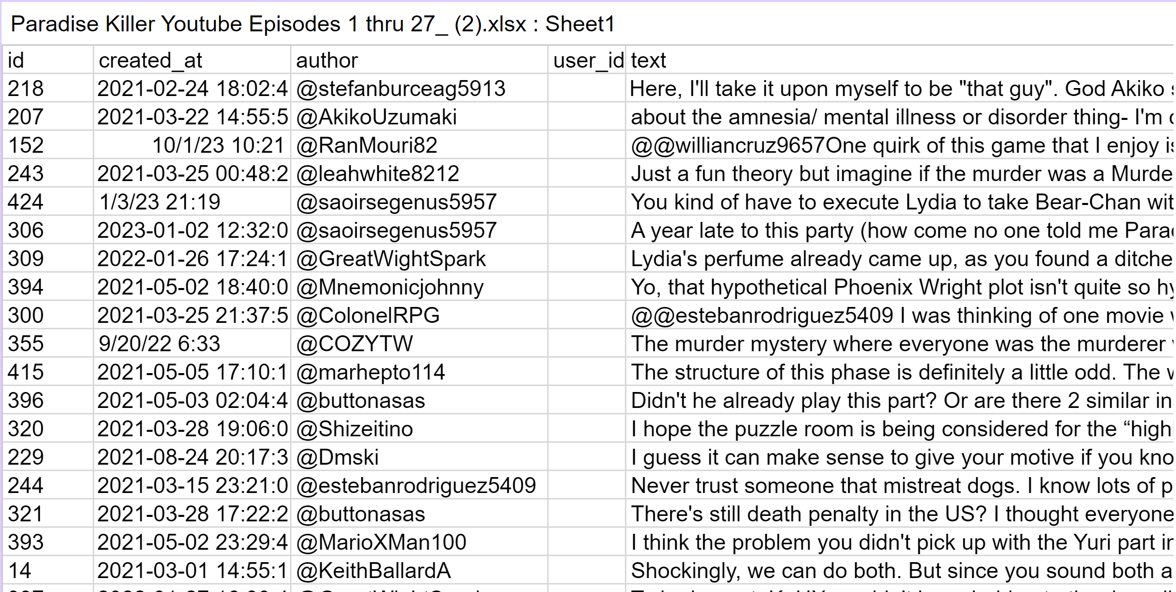

Slide 4
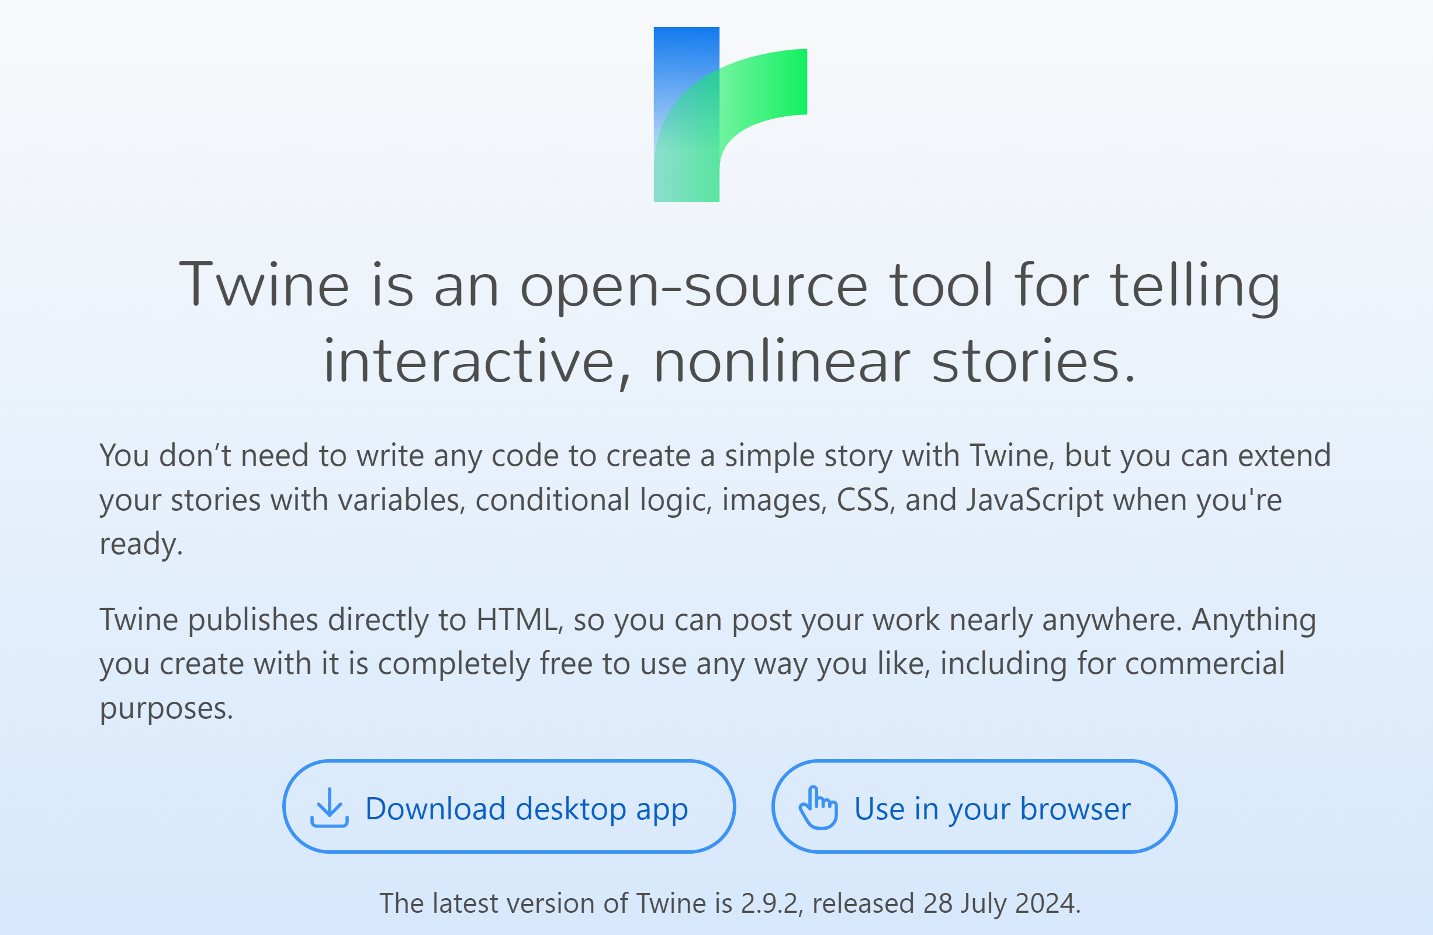
Twine: https://twinery.org/

Slide 5
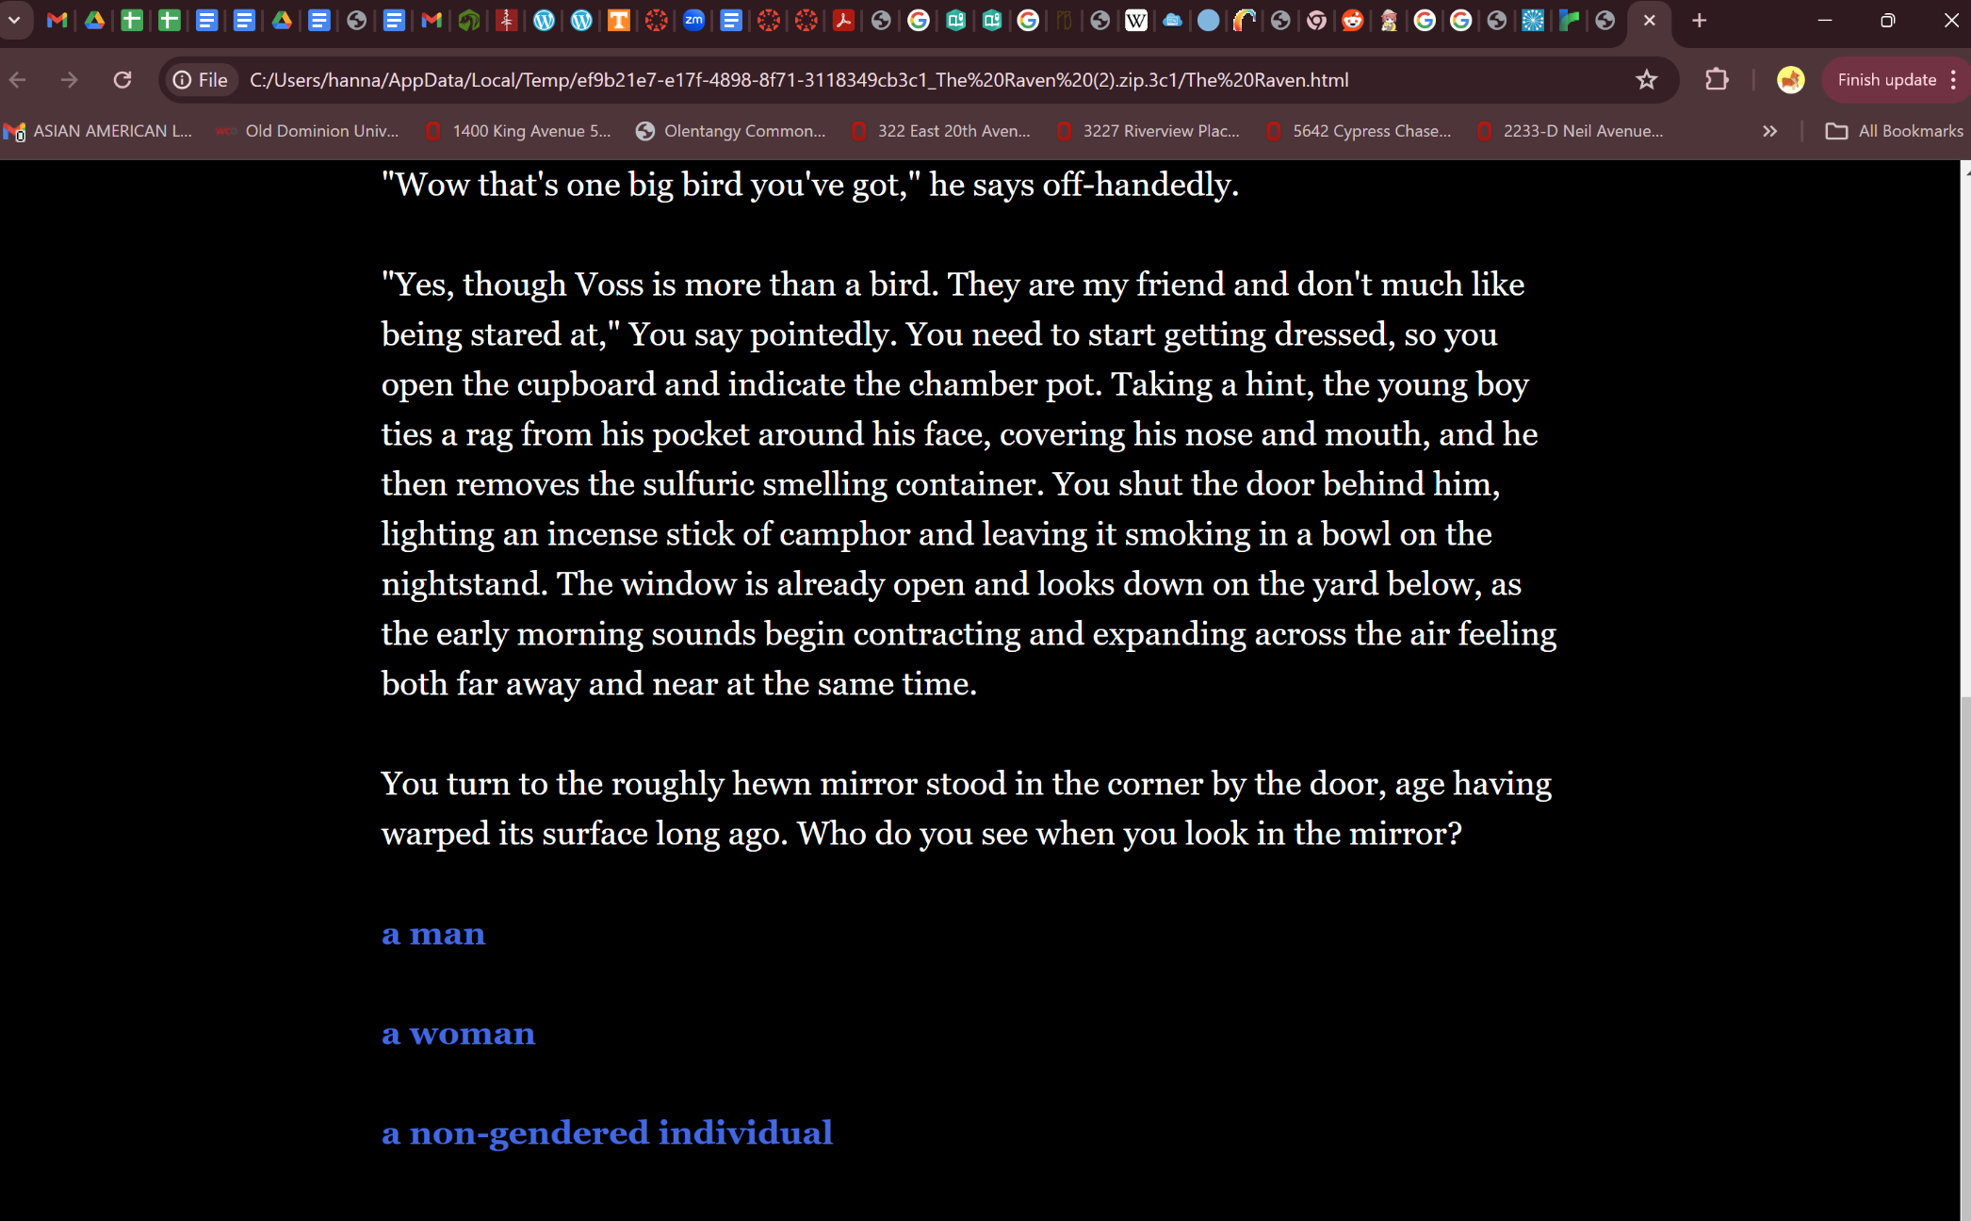
Student Project
https://hannahtrammell8.wordpress.com/engl-795-twine-project/

Slide 6

Scratch: https://scratch.mit.edu/educators

Slide 7
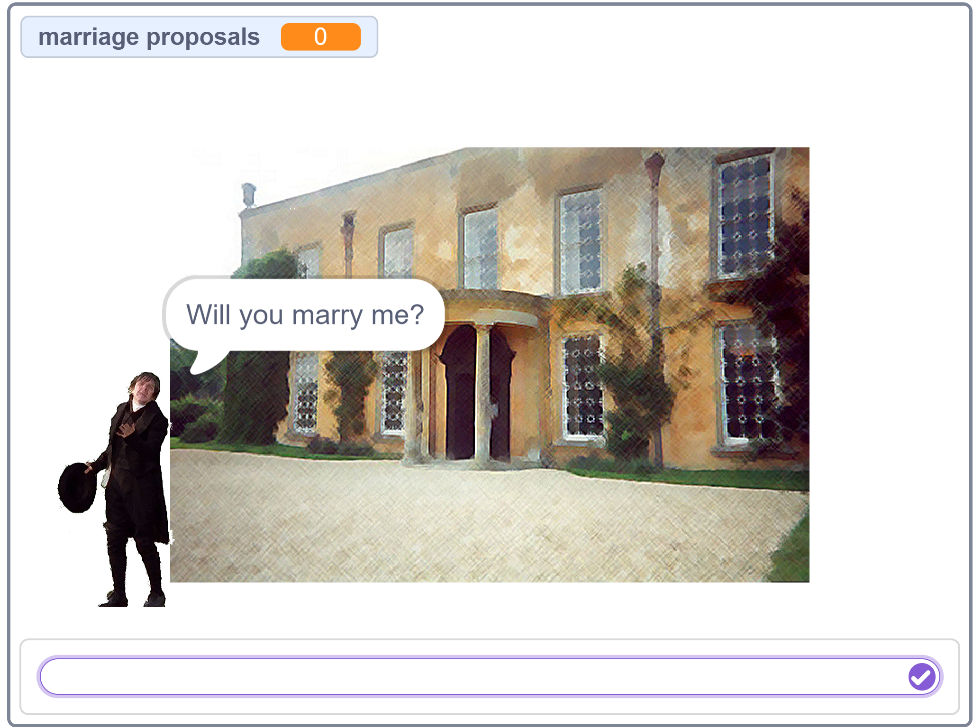

Slide 8
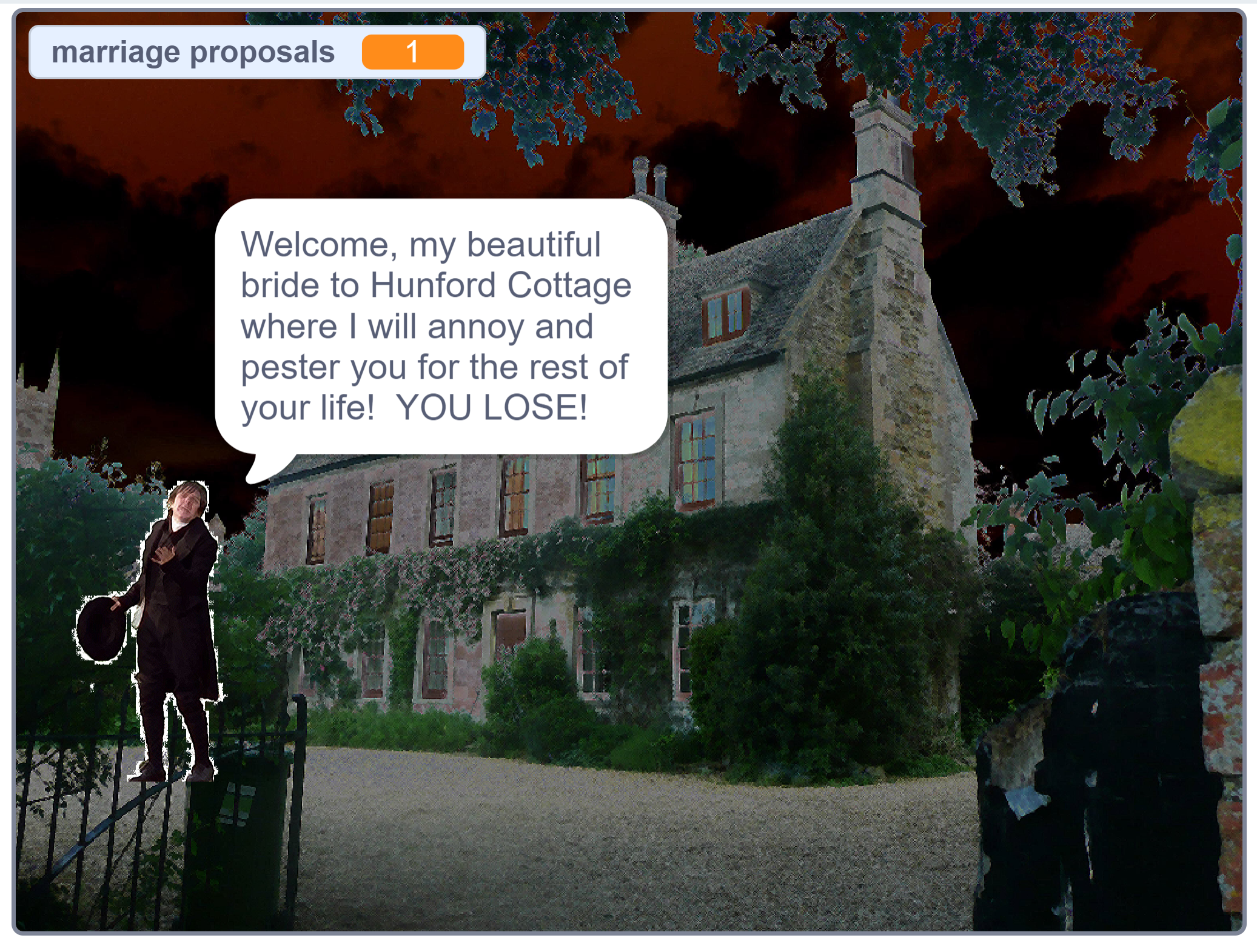

Slide 9
